Slide 1
Container Technologies Kenny Young Cloud Solutions Architect, Microsoft Blake Schoppa Sr Solution Engineer, Docker
Notes:
Optional:

Slide 2
Microsoft Container Technologies
Introduction to Containers
What are containers and why customers are turning to containers
Container adoption trends
Microsoft Container Technologies
Docker Container Offerings
References and call to action

Slide 3
Introduction to Containers
Notes:
Optional:

Slide 4
Customer’s pain points
Delivering same functionality to multiple deployment environments
Ensuring consistency and avoiding dependency hell
Unable to migrate and scale apps while maintaining compatibility
Source:
http://www.slideshare.net/dotCloud/why-docker
Notes:
Problem statement: Lets say you're going to test your app using Python 2.7 in development, and then it's going to run on Python 3 in production and something weird will happen.
Or you'll rely on the behavior of a certain version of an SSL library and another one will be installed. You'll run your tests on Debian and production is on Red Hat and all sorts of weird things happen.
And it's not just different software that can make a difference, The network topology might be different, or the security policies and storage might be different but the software has to run on it.
Customers need a way of bundling an entire runtime environment: an application, plus all its dependencies, libraries and other binaries, and configuration files needed to run it so that differences in OS distributions and underlying infrastructure are abstracted away. This way they can spend more time writing their apps than worry about underlying infrastucture and migration.

Slide 5
Challenges between developers and IT
Developers |  | IT
I need to create applications at a competitive rate without worrying about IT. |  | I need to manage servers and maintain compliance with little disruption.
New applications run smoothly on my machines but malfunction on traditional IT server. |  | I’m unsure of how to integrate unfamiliar applications, and I require help from developers.
My productivity and application innovation become suspended when I have to wait on IT. |  | I’m unable to focus on both server protection and application compliance.

Slide 6
What is a container?
Containers
Windows Server containers Maximum speed and density
= Operating system virtualization
OS
Container
Container
Container
Applications
Container
Container
Container
Kernel
OS
Hardware
Kernel
Traditional virtual machines = hardware virtualization
Hyper-V containers Isolation plus performance
Application
VM
VM
VM
Container
Container
Container
OS
Hardware
Kernel
Kernel
Kernel
Hyper-V
Notes:
When it comes to applications, historically, IT administrators deployed with a 1:1 application to server ratio. When a new application was required by the business, it was deployed onto a newly provisioned physical system, to ensure no conflicts with existing applications and workloads. This resulted in a huge number of physical servers, all with very low utilization.
Fast forward to a more modern datacenter, where virtualization is now prevalent, and you’ll find significantly higher consolidation ratios, much greater utilization and significantly accelerated app deployment speeds as administrators deploy applications in minutes, compared with hours, days or weeks in a purely physical datacenter.
Compared with applications that ran on individual physical servers, the compatibility of those same apps to run inside virtual machines was typically very high. After all, the virtual machine just presents virtual hardware to the same operating system that was running in the physical world. The only consideration being, if that application or workload has a requirement for a specific piece of hardware, such as a PCI-E card, that couldn’t be virtualized and presented through to the guest operating system. In addition, once that application was encapsulated inside the virtual machine, it benefited from higher levels of redundancy, and also mobility, through features such as live migration.
There is however, a new and increasingly popular way to build, ship, deploy and instantiate applications. Containers can further accelerate application deployment and streamline the way IT operations and development teams collaborate to deliver applications to the business.
But what are containers? Well, to give the computer science definition, containers are an operating system-level isolation method for running multiple applications on a single control host. With developers building, and then packaging their applications into containers, and providing them to IT to run on a standardized platform, it reduces the overall effort to deploy applications, and can streamline the whole dev and test cycle, ultimately reducing costs. As containers can run on a host OS which itself could be physical or virtual, it provides IT with flexibility, and the opportunity to drive an increased level of server consolidation, all whilst maintaining a level of isolation that allows many containers to share the same host operating system.
Windows Server containers are isolated behind their own network compartment. This can be provided a NAT DHCP or Static IP. Each container has an independent session namespace, which helps to provide isolation and security. The kernel object namespace is isolated per container.
Hyper-V Containers take a slightly different approach to containerization. To create more isolation, Hyper-V Containers each have their own copy of the Windows kernel and have memory assigned directly to them, a key requirement of strong isolation

Slide 7
Container benefits A new approach to build, ship, deploy, and instantiate applications
Applications traditionally built and deployed onto physical systems with 1:1 relationship.
New applications often require new physical systems for isolation of resources.
Package and run apps within containers.
Physical/ Virtual
Physical
Higher consolidation ratios and better utilization.
Faster app deployment than in a traditional, physical environment.
Apps are deployed into VMs with high compatibility success.
Apps benefit from key VM features, such as live migration, HA.
Key benefits
Further accelerate app deployment.
Reduce effort to deploy apps.
Streamline development and testing.
Lower costs associated with app deployment.
Increase server consolidation.
Virtual
Notes:
But why do we need containers? What do containers provide that virtual machines can’t? Who is driving the momentum behind containers?
Applications are fueling the innovation in today’s cloud-mobile world, and developers hold the keys to the power of those applications. The more streamlined and efficient the process for developers to build and deliver their applications, the faster that more powerful applications can reach the business. This however, has to work across both the developers, and IT who hold the keys when it comes to the infrastructure that the applications will run on.
For the developers, containers unlock huge gains in productivity, and freedom – the ability to build an application, package within a container, and deploy, knowing that wherever you deploy that container, it will run without modification, whether that is on-premises, in a service provider’s datacenter, or in the public cloud, using services such as Microsoft Azure. These containers don’t have to be deployed independently – developers can model complex multi-tier applications, with each tier packaged within a container, and these can be distributed across IaaS and PaaS models, again, increasing the overall surface area that the developer can aim for when releasing their application. This powerful abstraction of microservices architectures provides developers with incredible potential to deliver applications more rapidly than ever before. They can’t however, do it without the Operations’ team support.
On the Operations side, they benefit considerably by being able to gain ever higher levels of consolidation for applications and workloads than even virtualization could provide, and in addition, they can put in place a platform that can rapidly scale up and down to meet the changing needs of the business. This standardized platform is easier to manage, yet provides the developers with a consistent environment into which they can simple provide their app, and hit ‘run’.
This integration across development and operations is what’s becoming known in the industry as DevOps. DevOps aims to integrate people, process and tools to streamline the application development and deployment process. Ops can focus on providing a standardized infrastructure and a set of resources that can be consumed by the development teams, and developers can focus on designing, building, packaging and testing their applications, using the platform that IT provide.

Slide 8
Container overview
Dependencies: Every application has its own dependencies which include both software (services, libraries) and hardware (CPU, memory, storage).
Virtualization: Container engine is a lightweight virtualization mechanism which isolates these dependencies per each application by packaging them into virtual containers.
Shared host OS: Processes in containers are isolated from other containers in user space, but share the kernel with the host and other containers.
Flexible: Differences in underlying OS and infrastructure are abstracted away, streamlining ‘deploy anywhere’ approach.
Fast: Containers can be created almost instantly, enabling rapid scale-up and scale-down in response to changes in demand.
Container
App A Bins/Libraries
App B Bins/Libraries
Host OS w/Container Support
Server
Notes:
Now that we understand a little more about why containers are important to both operations, and developers, it’s important to understand just what is a container.
As you can see from the graphic on the right hand side, at the base we have a server. This could be physical, or virtual, and at this stage, it doesn’t matter. On that server, is a host operating system, which, for the purpose of a containers discussion, has container support within the kernel.
If you think about an application, each app tends to have it’s own dependencies. This could include software, such as services, or libraries, or it could have hardware dependencies, such as CPU, memory, or storage. The container engine that exists within the host OS is essentially a lightweight virtualization mechanism which isolates these dependencies on an application by application basis, by packaging them into virtual containers.
The differences in underlying OS and infrastructure are abstracted away – as long as the base image is consistent, the container can be deployed and run anywhere, which for developers, is incredible attractive.
These containers run as isolated processes in user space, on the host operating system, sharing the kernel with other containers. These containers can be created also instantly, which unlocks rapid scale-up and scale-down scenarios in response to changes in demand from the business.

Slide 9
Containers offer unique capabilities
Fast iteration
Defined state separation
Resource controls
Immutability
Rapid deployment
Notes:
Containers are attractive for developers and for IT for a number of reasons:
Fast iteration: Containers allow for rapid iteration through the development process both because they are lightweight and because of the way the application is packaged with its dependencies
Defined state separation: Changes to the container don’t affect other containers.
Resource controls: The host controls how much of the host’s resources can be used by a container. Governing resources like CPU, RAM and network bandwidth ensure that a container gets the resources it expects and that it doesn’t impact the performance of other containers running on the host.
Immutability: Changes made within one container won’t affect containers running on the same host.
Rapid deployment: Since containers are lightweight in terms of resources, they are easy to move, copy, and share. This enables rapid application deployment.

Slide 10
Container Adoption Trends
Notes:
Optional:

Slide 11
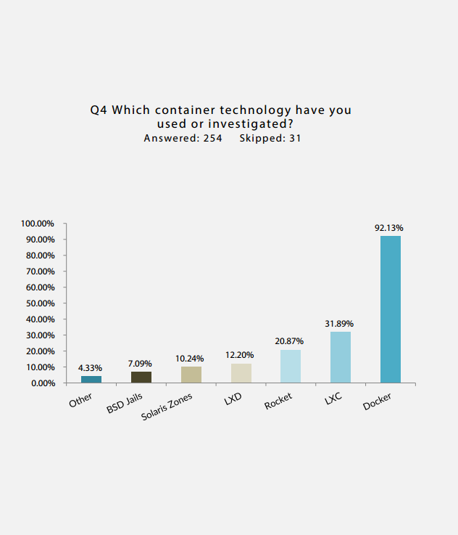
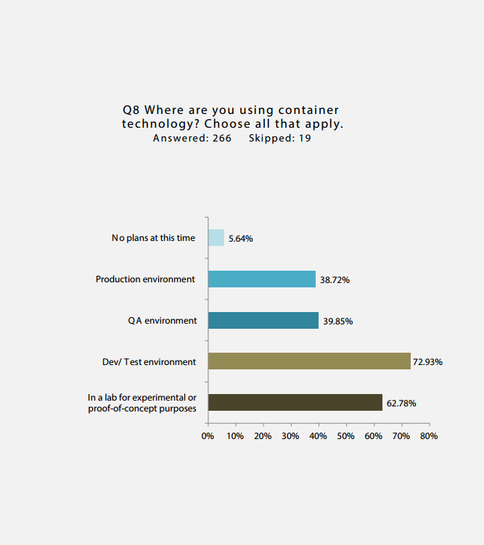
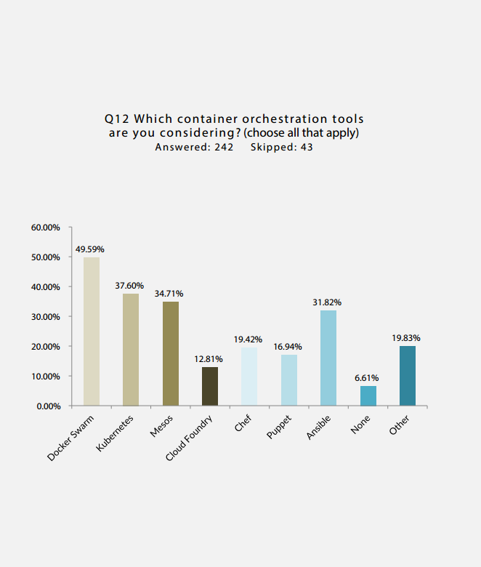
Container adoption trends
Q4 Which container technology have you used or investigated?
Answered: 254 Skipped: 31
Q8 Where are you using container technology? Choose all that apply.
Answered: 266 Skipped 19
Q12 Which container orchestration tools are you considering? (choose all that apply)
Answered: 242 Skipped: 43
* DevOp survey
https://clusterhq.com/assets/pdfs/state-of-container-usage-june-2015.pdf
Notes:
Graphic 1:
Docker Adoption is up 30% in one year.
Docker now runs on 10% of Datadog monitored host
Large companies are leading adoption
Graphic 2:
Lots of companies trying containers in Dev/Test and in PoC environments, but not in production. Its one thing to run simple container in dev/test and another to run a highly scalable production grade container platform. Need a solid orchestration platform to achieve the latter [plug for ACS]
Graphic 3:
Call out Swarm and Mesos as popular container orchestration platforms, with rising interest for Kubernetes.

Slide 12
Container Revolution, powered by Docker
Containers have been around many years
Docker Inc. did not invent them, but created open source software to build and manager containers
Docker is the most popular container packaging format
Docker Inc. makes containers easy by providing easy developer tooling
Docker Inc. has built a strong open source community around containers

Slide 13
Surging popularity of Docker
Docker Community passes 5 billion pulls from Docker Hub
Real Docker adoption is up 30% in one year
Docker now runs on 10% of hosts monitored by Datadog
Large enterprises are leading Docker adoption
2/3rd of companies that try Docker, adopt it ; and adopters 5X their container count within 9 months

Slide 14
Microsoft Container Technologies
Notes:
Optional:

Slide 15
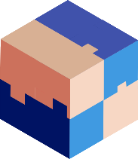

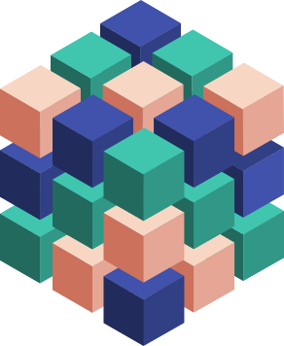
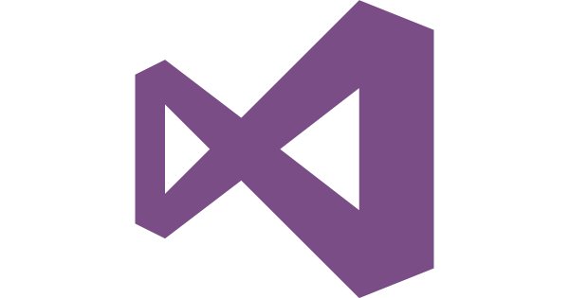
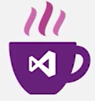
Microsoft & Containers – Better together
Any OS
Arsenal
Linux containers, Windows Server Containers and Hyper-V Containers
Run on-premises, on Azure, on other public clouds, service provider clouds
Monoliths, Microservices and other app types
Development frameworks and environments supported: Microsoft and Ecosystem
Container Management solutions: Microsoft and Ecosystem
Linux
Windows
Anywhere
On-premises
Hosted
Any App
Monolith
Microservice
Any Language
.Net
Java

Slide 16
3 Messaging Pillars for Microsoft Container Technologies
Developer Productivity tools for container application lifecycle management
Ship products faster and more often with DevOps and containers
Image registry
24X7 continuous operations with integrated container monitoring
Identity and Access management
Microsoft
Solutions
Ecosystem
Solutions
Integrated Tooling
Azure
Azure Stack
On-Premises
Public or Service Clouds
Hybrid Deployment
Total choice across the IaaS<->PaaS continuum
Use the same tools, APIs, frameworks that you love
App modernization using Re-host, Re-factor,
Re-design or Re-build
Flexibility and Choice

Slide 17
Eagle’s view: Microsoft Container Technologies
Windows Server Containers
Service Fabric
App Service
Container Services
Docker Windows Server 2016
Microservices platform with
Windows and Linux Containers
Single Container Apps
Open Source
Visual Studio and Visual Studio Team Services + Operations Management Suite for Containers
Open Source CI/CD and Monitoring for Containers

Slide 18
Why does Microsoft offer the best container solution in the industry
Microsoft + Containers supports 98% of all enterprise workloads
A la carte and set menu options for containers
Prescriptive “Golden paths” to ease your container adoption
Full stack container solution for Dev->DevOps->Production->Monitoring loop using Microsoft and ecosystem technologies
Container solutions for every step of your journey to cloud
Widest range of options and choice available in the industry
Deep partnerships with popular container vendors including Docker, Mesosphere, Red Hat and many more.
Leading innovation in Kubernetes ecosystem
Full cloud stack solution from VMs, Containers to PaaS and Serverless
Multiple reference customers running their large scale container solution on Azure and On-premises successfully.

Slide 19
How do you deploy Azure Container Service?
Portal
Set up ACS cluster with few clicks
ARM template
Use well known ARM templates available in Github
Command Line Interface
Use Azure CLI to deploy ACS cluster
Templates available for DC/OS, Docker Swarm and Kubernetes
Save the generated ARM templates for future deployments
Configuration commands available to create and manage ACS clusters

Slide 20
Any cloud
Operations
Management
Suite
Container Solution
Any platform
Notes:
Optional:

Slide 21

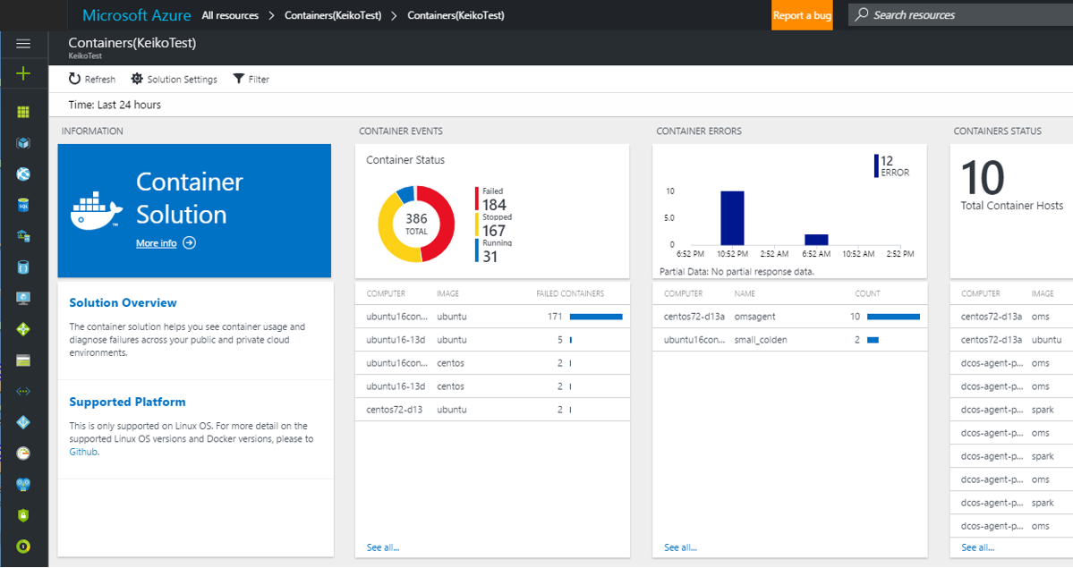
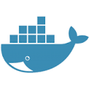
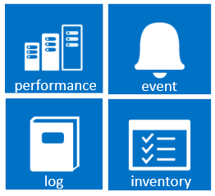
UNIFIED EXPERIENCE
COLLECT AND INDEX DATA
SEARCH AND INVESTIGATE
CORRELATE AND ANALYZE
VISUALIZE AND REPORT
MONITOR AND ALERT
Gain immediate insight from containers
Containers are lightweight, pared-down virtual machines that can be easily provisioned, developers have created them sporadically as a solution to support their continuous delivery. As containers are being used widely in production and are exploding in numbers, demand for container monitoring has increased. A centralized approach to logging and monitoring is required. OMS Container Solution helps with these needs.
https://blogs.technet.microsoft.com/msoms/2016/08/24/announcing-public-preview-oms-container-solution-for-linux/

Slide 22
Docker
Notes:
Optional:

Slide 23
Docker EE Components
Docker Universal Control Plane
Enterprise Class Support SLAs
End-to-End Security
Supports Greenfield and Legacy Apps
Infrastructure and OS Independence
Docker Trusted Registry
Certified Containers and Plugins
Docker EE Engine
Integrations and API Support

Slide 24
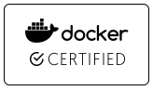
Docker EE CaaS Workflow
DEVELOPERS
IT OPERATIONS
Microservices
Security scan & sign
Image Registry
Control Plane
Traditional
docker store
Third Party

Slide 25

Docker EE Architecture
Admin / User
Deploy / manage
Logging
Raft consensus group
Monitoring
Internal distributed store
LDAP/AD
push / pull
UCP Manager
UCP Manager
UCP Manager
External CA
Image Storage
BYO TCP Load Balancer
DTR Replica Worker
DTR Replica Worker
DTR Replica Worker
UCP Worker
UCP Worker
UCP Worker
UCP Worker
Image Registry

Slide 26
Value of Docker EE Subscription
Official Technical Support
Dedicated support engineers and SLAs
Only available from Docker
Stable
Predictable release cadence
Long supported versions
Backport defect fixes
Direct Product Roadmap Ownership
Directly responsible for Commercial product roadmap and direct influence of OSS product roadmap.
Secure
Address vulnerabilities
Hotfixes
Integrations and API Support
Docker native toolset
Access to the broadest ecosystem
Validated Configurations
Validated operating systems, configurations and interoperability

Slide 27
References
Notes:
Optional:
Service Fabric—Microservice Based Apps
Azure Service Fabric is a platform that developers and ISVs can use to build and manage custom microservice-based applications at cloud scale and with 24x7 availability. Microservices are an architectural approach based on fine-grained, loosely coupled services that can enable advanced developer agility, cloud scale, self-healing resilience and always on availability. Service Fabric is the foundation for many Microsoft services such as Azure SQL Database, Azure Document DB, Cortana, Windows Intune, and Skype for Business. We’ve taken the exact same technology and made it available to you. And use Service Fabric wherever you want to run your microservice based apps—whether in Azure, in your own datacenter or in other clouds—giving you maximum flexibility.

Slide 28
So what should you do next?
Azure App Service
Azure Functions
Try: https://functions.azure.com/try
Azure Service Fabric
Try: http://aka.ms/tryservicefabric
Azure Container Service
Try: http://aka.ms/acs
Try: https://tryappservice.azure.com
Ignite Session: Master modern PaaS for the enterprise with Azure App Service [BRK3205]
Ignite Session: Build applications with SF [BRK1036]
Ignite Session: Go serverless for the enterprise with Azure Functions [BRK2250]
Ignite Session: Deep Dive into ACS [BRK4008]
Download “Understanding Azure - a guide for developers” http://aka.ms/adg
The Total Economic Impact of Microsoft Azure PaaS https://azure.microsoft.com/resources/total-economic-impact-of-microsoft-azure-paas/

Slide 29
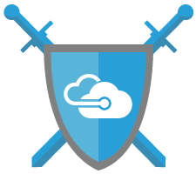
Windows Server Next steps
Learn more about Windows Server 2016: www.microsoft.com/WindowsServer2016
Review Windows containers documentation:
http://aka.ms/containers
Windows Server blog: http://blogs.technet.microsoft.com/windowsserver

Slide 30
Learn more about Containers on App Service
All our docs: https://aka.ms/webapp-linux
FAQ: https://aka.ms/linux-faq
Release notes: https://aka.ms/linux-release-notes

Slide 31
OMS
Github
https://github.com/Microsoft/OMS-Agent-for-Linux
Dockerhub – “microsoft/oms”
https://hub.docker.com/r/microsoft/oms/
Demo on OMS Experience Center
Go to https://oms-experience-center-2016.portal.mms.microsoft.com/
Blog
https://blogs.technet.microsoft.com/msoms/tag/keiko-harada/
OMS Documentation
https://docs.microsoft.com/en-us/azure/log-analytics/log-analytics-containers
Feedbacks
Email OMScontainers@microsoft.com

Slide 32
ACS References
Landing Page
aka.ms/acs
Documentation
https://azure.microsoft.com/en-us/documentation/services/container-service/
ARM Templates for Creating Azure Container Service
DC/OS: https://github.com/Azure/azure-quickstart-templates/tree/master/101-acs-dcos
Swarm: https://github.com/Azure/azure-quickstart-templates/tree/master/101-acs-swarm
Kubernetes: https://github.com/Azure/azure-quickstart-templates/tree/master/101-acs-kubernetes
Azure Container Service 101
https://channel9.msdn.com/Shows/Azure-Friday/Azure-Container-Service-101?ocid=player
Building applications using Azure Containers Service
https://channel9.msdn.com/Events/Build/2016/B822?ocid=player
Deep dive into Azure Container Service
https://channel9.msdn.com/Events/Ignite/2016/BRK4008-TS

Slide 33
ACS References
Videos and Podcasts
Azure Friday: Azure Container Service 101
https://channel9.msdn.com/Shows/Azure-Friday/Azure-Container-Service-101
Azure Friday: Scaling Azure Container Service
https://channel9.msdn.com/Shows/Azure-Friday/Scaling-Azure-Container-Service
//Build 2016: Building Applications Using the Azure Container Service
https://channel9.msdn.com/Events/Build/2016/B822
Interview: Azure Container Service Strategy
http://www.microsoftcloudshow.com/podcast/Episodes/115-azure-container-service-acs-with-microsoft-s-ross-gardler?utm_content=buffereb3c1&utm_medium=social&utm_source=twitter.com&utm_campaign=buffer
Demo: Introduction to Docker and Azure Container Service
https://channel9.msdn.com/Shows/Cloud+Cover/Episode-198-Azure-Container-Service-with-Ross-Gardler
Demo: Getting started developing with Docker and Azure Container Service
https://channel9.msdn.com/Events/Visual-Studio/Connect-event-2015/915

